Slide 1


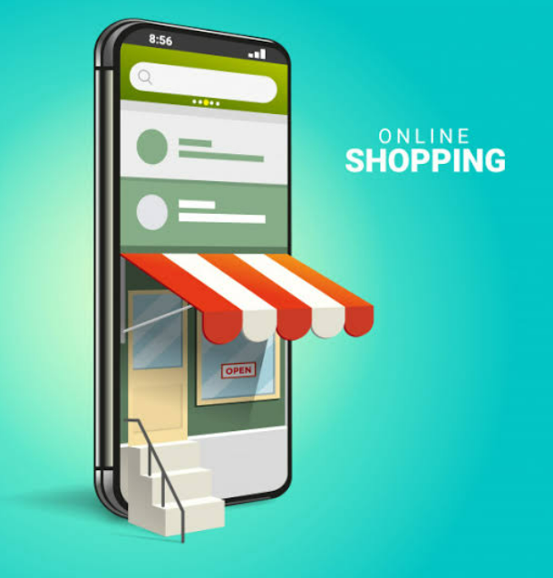
PRESENTED BY:
1.K.MONICA
2.J.G.PAVITHRA
3.M.PREETHIKA
4.P.KUNDHANA SREE

Slide 2

INTRODUCTION TO ONLINE SHOPPING
It is a form of electronic commerce which allows the customer to directly buy goods over internet using web browser or mobile app.
This enables the customer to shop online using a range of different computers,PC,tablet etc…

Slide 3

THE APP ICON
The first step in developing the app is choosing the app icon.
The pictorial representation of the app is important to catch the users attention.

Slide 4
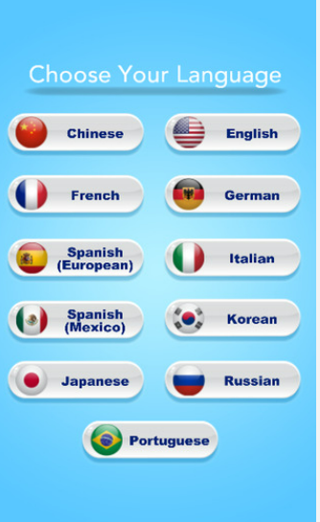
THE LANGUAGE CHOOSING OPTION
It helps the user to use the app in his/her own language than the other foreign language.

Slide 5
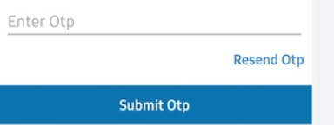
OTP OPTION
Through mobile number entering option one can verify the user account by sending OTP to that number.
This also provides security to the user application.

Slide 6
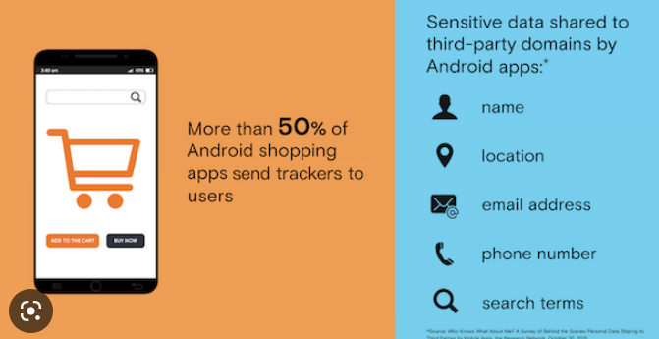
PERSONAL INFORMATION
This includes their name,hobby,favourite colour etc…
Through this we can list the items which they prefer at first.

Slide 7
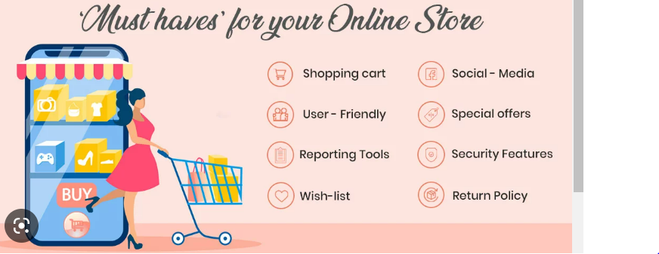
FEATURES INCLUDING RETURN POLICY
The features includes the search button for the product they want to buy,account information details,notification,different categories and category of their liked and carted page ,special offers,special offers etc…
It also have return policy through which they can return after a period of time if there is a defective piece

Slide 8

SHOPPING
It saves time .
It gives discount .
Convinience from home.
Can compare with various
models.

Slide 9
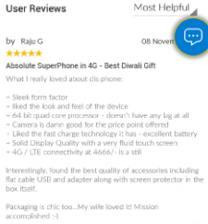
REVIEW
It allows the user to give the review about a product through which others can buy that model.
It allows the user to give the feedback through which we can be motivated.
It also allows the user to tell their problems and also gives solution to their problems

Slide 10


